Slide 1
DSAI Project
FSP4_Team05:
Sng Yi Xuan U2021009B
Timothy Chang U2022114A
Ivan Lua U2022506F

Slide 2


Notes:
550 BILLION DOLLARS. Thats how much disengaged traders lose on average every day. Pure speculation as well as emotional trading are cited as key factors of unprofitable trading. So, how should investors trade as to ensure profits?
Hi, we are Team 5, a group of student investors, and with the power of machine learning, we are here to turn your losses into profits.

Slide 3

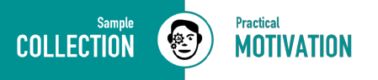
Mission statement:
To identify which companies are good to invest in, and help investors build a diversified portfolio
Notes:
Our mission is to help investors build a diversified portfolio by conducting intensive analysis of company’s financial data.
Based on our knowledge of financial accounting, we are able to use financial reports to produce several important ratios that dictate the investment worthiness of a company. But, is that all we can do to reach an informed decision?
NO. After learning about Data Science and Machine Learning, we have discovered an abundance of tools to provide a unique understanding of the stock market and financial data.

Slide 4

Notes:
Introducing Alphavantage. It offers free APIs for real-time and historical data of stocks, such as the balance sheet, income statement and cash flows of a company.
From here, we can obtain financial ratios from the company overview, and further generate and calculate fundamental data of various companies from their financial statements

Slide 5
Problem Statement
Given financial information powered by AlphaVantage, how may we develop a solution to identify strong companies and recommend a diversified portfolio to investors?
20XX | 20XX | 20XX | 20XX
Notes:
Hence our problem statement. Given financial information powered by AlphaVantage, how may we develop a solution to identify profitable companies and recommend a diversified portfolio to investors?

Slide 6
Data Extraction
Exploratory Analysis
Our Approach
Machine Learning
Clustering
Notes:
To start off, we will delve into the financial data extraction of companies, followed by an in-depth exploratory analysis and then a clustering of stocks using machine learning.

Slide 7
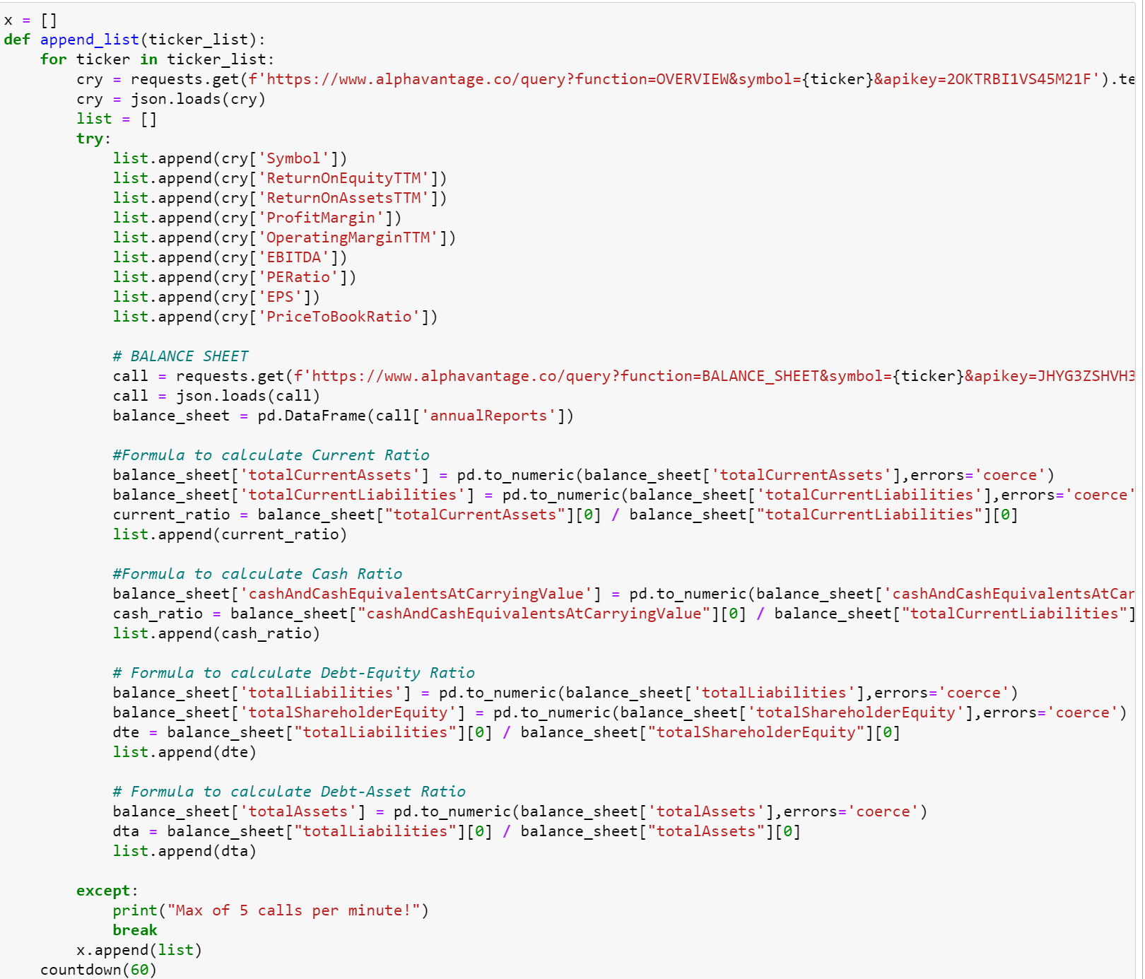
Data Extraction and Cleaning
Calling API
Extracting Fundamental Data
Total Assets
Total Liabilities
Current Ratio =
Total Cash
Total Current Liabilities
Cash Ratio =
Notes:
Firstly, we extract several significant data such as return on equity and eps which can be extracted directly from the Company’s Overview financial statement.
However, not all of the financial ratios can be extracted directly from the financial statement. For example, current ratio and cash ratio are not directly available and has to be derived separately. As such, we perform some exploratory analysis to calculate current ratio by dividing the reported total assets by the total liabilities which are available in the company’s balance sheet statement.

Slide 8
Data Extraction and Cleaning
Calling API
Extracting Fundamental Data
Total Liabilities
Total Shareholders Equity
Debt-Equity Ratio =
Total Liabilities
Total Assets
Debt-Asset Ratio=
Notes:
Debt to Equity and Debt to Asset Ratios are some other insightful figures that measure a company’s financial leverage. We can also obtain them by manipulating extracted data from the balance sheet. More on exploratory analysis will be covered soon.

Slide 9

Data Extraction and Cleaning
What to do with NaN values?
Removing all rows with NaN
Imputing data using interpolated values e.g. Mean
e.g. Missing value for CDNS (2017) in 'ReturnOnAssetsTTM', resulted in removal of CDNS as one of the stocks used in clustering analysis.
Rationale: While (B) would achieve a balance between preserving sample size and data integrity, there are only a minute amount of missing values, and removing all rows with NaN values would not severely reduce the sample size, thus (A) would not make these unsupervised learning models significantly less accurate.
Notes:
In dealing with NaN values, we had to choose between removing all rows with NaN values, or imputing data using interpolated values, like Mean. For this study, we chose to adopt the former, where random missing values for a stock would result in removal of the entirety of the row.

Slide 10
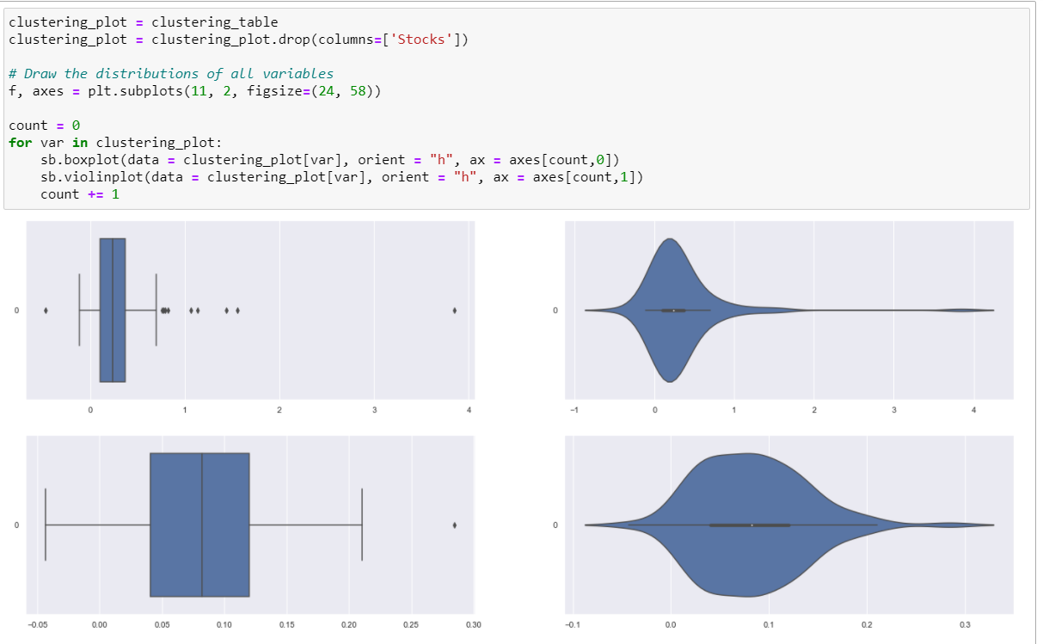
Exploratory Analysis
Notes:
Now we have extracted all our data into the dataframe clustering_table.
To summarise, and visualise our acquired data, we ran an exploratory analysis using boxplots and violinplots. From the plots we obtained, we recognised patterns in the distribution across all companies’ data for a given indicator, such as return on equity.
For instance, this boxplot indicates that there is a large spread across all the values, instead of being all clumped together, which further suggests that we could possibly identify multiple clusters of companies for the certain indicator.

Slide 11


The solution
Clustering
Notes:
Thanks to Exploratory Analysis, we are now able to visualise and identify patterns in the financial indicators provided by AlphaVantage. But even after this, we still do not know which companies are the best overall.
Hence, our solution will apply the machine learning technique of clustering. Clustering will allow us to distinguish certain groups of companies based on certain key characteristics, and isolate the best performers for that specific indicator.

Slide 12
4 Categories of Financial Ratios
Profitability: Return on Equity (ROE) Return on Assets (ROA) Gross Profit Margin Operating Margin | Market Prospects: Price-to-Earning Ratio Earnings per Share (EPS) Price-to-Book Ratio
Liquidity & Efficiency: Current Ratio Cash Ratio | Solvency: Debt to Equity Ratio Debt to Asset Ratio
Notes:
Based on our accounting knowledge, we have come up with 4 preliminary metrics to assess a company’s financial position.
Profitability helps provide insight into how much profit a company generates and how that profit relates to other important information about the company.
Market Prospect primarily integrate a company’s publicly traded stock price to give investors an understanding of how inexpensive or expensive the company is in the market.
Liquidity measures how quickly a company generates cash to buy additional assets or repay its debts quickly.
Solvency ratios are used by investors to get a picture of how well a company can deal with its long-term financial obligations. For example, investors will generally avoid companies with more long term debts.
We will perform four rounds of clustering, one for each category.

Slide 13
Initialisation
Clustering
Evaluation
Elbow Method to find optimal k
Create our clustering algorithm
Perform four rounds of clustering based on:
Profitability
Market Prospects
Liquidity & Efficiency
Solvency
Identify the best performing companies which rank highly across several clusters
Notes:
The clustering approach will follow the above 3 step process. Initialisation, clustering and evaluation.
Secondly, we will execute the algorithm for each of the four metrics as discussed previously.
Lastly, we will look at the better performing clusters, and extract the individual companies that appear most often. These will be the companies investors should watch out for.

Slide 14
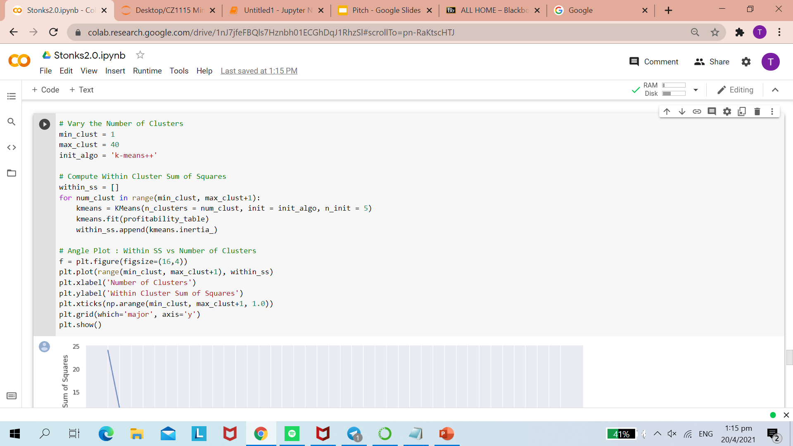
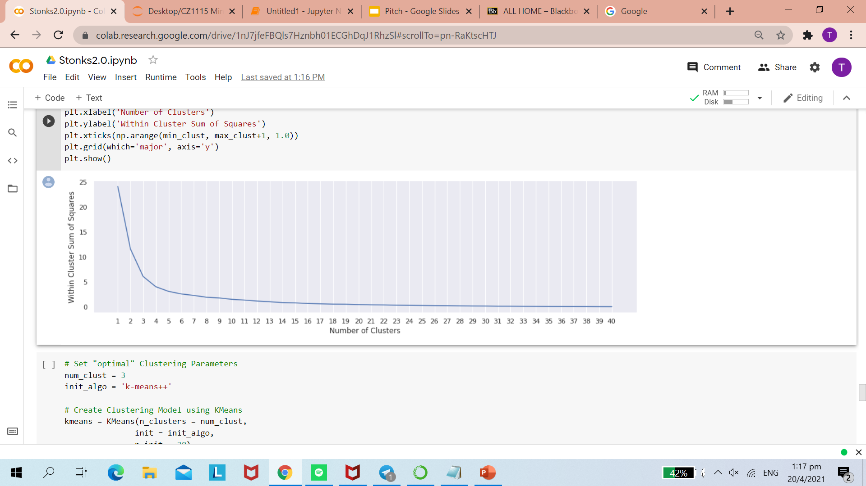
Elbow Method
To identify the optimal k for number of clusters
Notes:
Firstly, we adopt the elbow method to find the optimal number of clusters for our algorithm. This is done by finding the Within Cluster Sum of Squares Following which we will use the k-means algorithm that will help us identify the centroids of each cluster and then partition the data that fit.

Slide 15
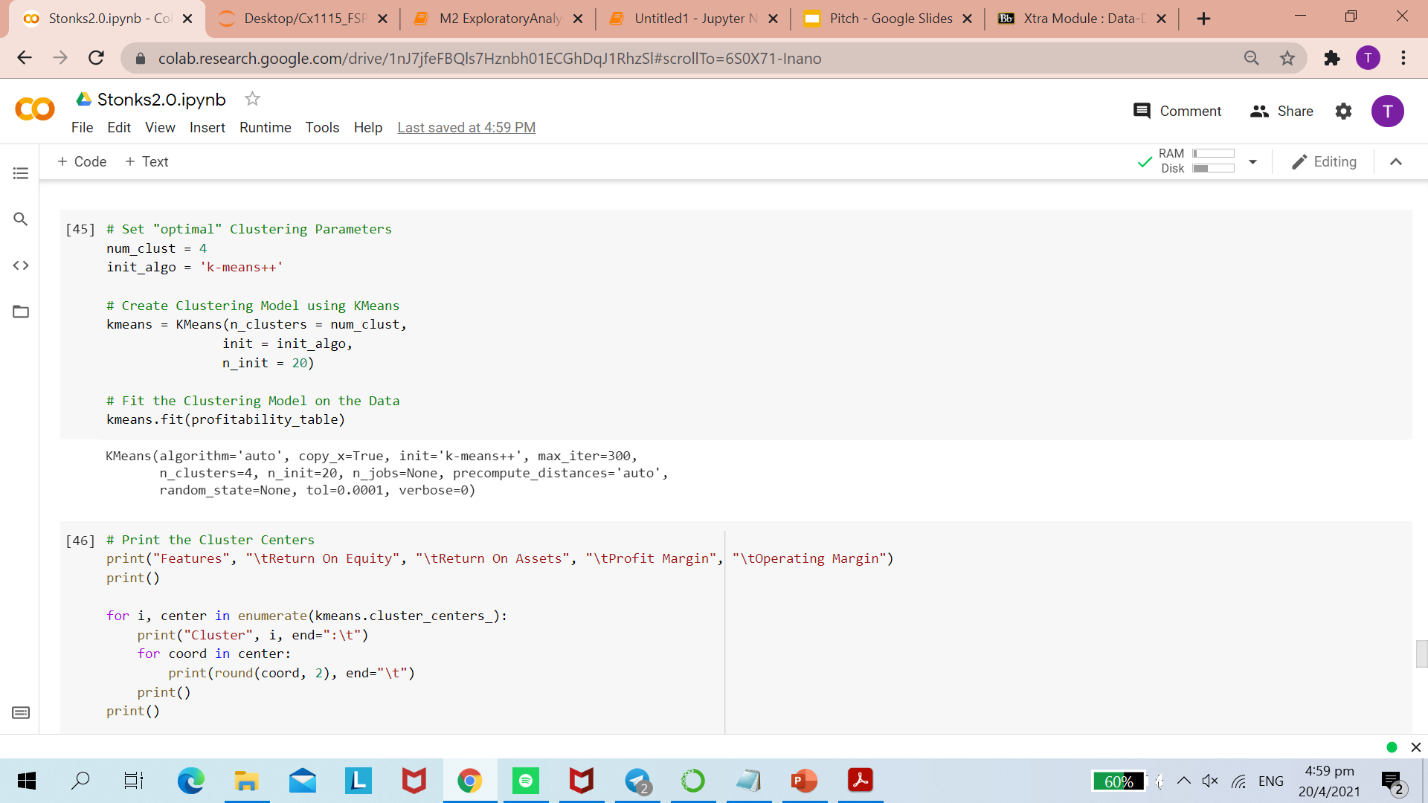
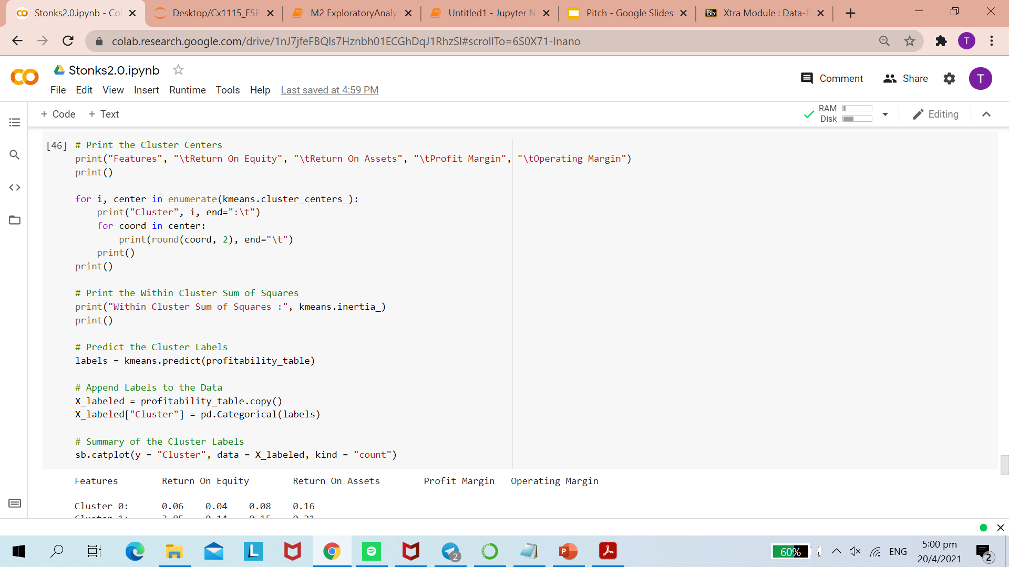
Clustering Algorithm
Notes:
Secondly, we will execute the algorithm for each of the four metrics as discussed previously. The clusters will be formed and we can proceed to the next step, Evaluation.

Slide 16
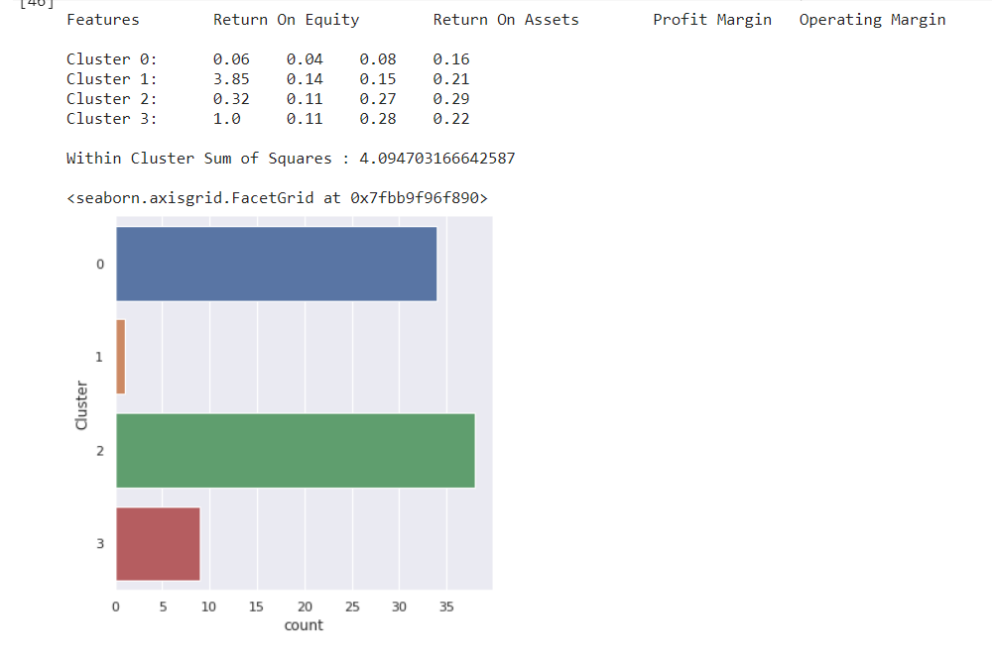
Notes:
The algorithm will first produce a counts plot with the number of companies in each cluster.

Slide 17
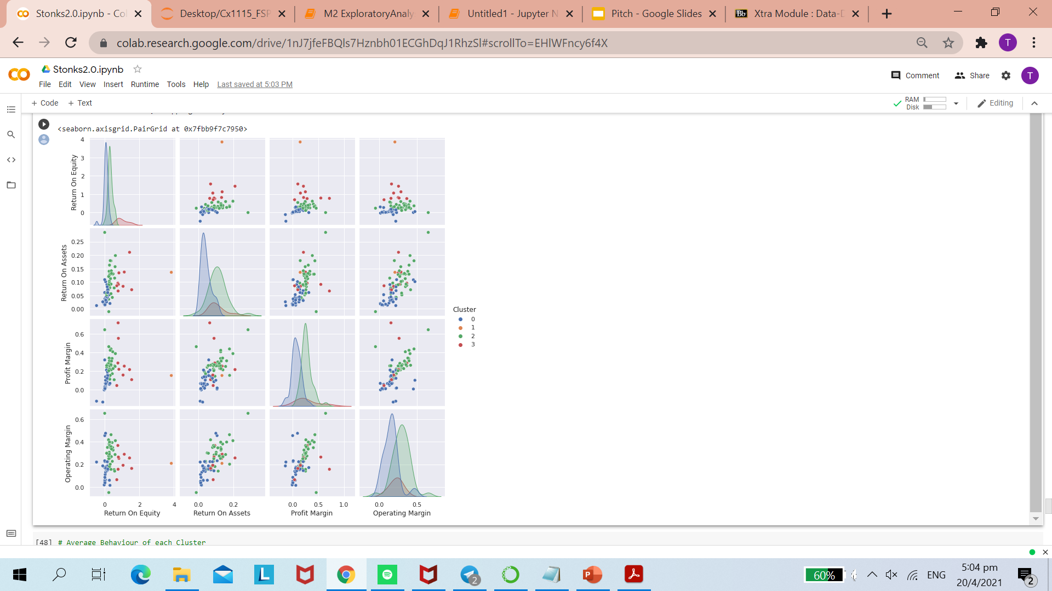
Notes:
This pairplot provides us with a visualisation of each cluster’s relative position.

Slide 18
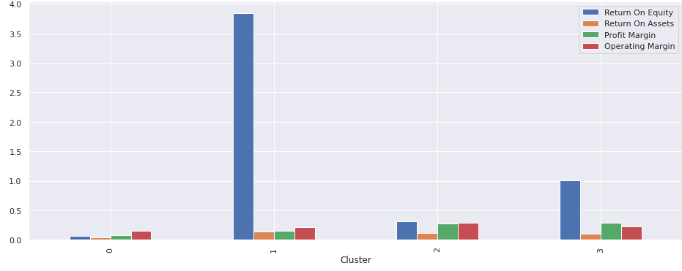
Notes:
From this histogram, however, we are able to have a birds eye view of the four clusters, going into details of the strengths and weaknesses of each cluster. Furthermore, we are able to spot outliers such as the extremely high return on equity of cluster 1.

Slide 19
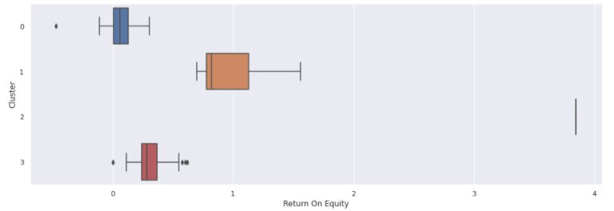
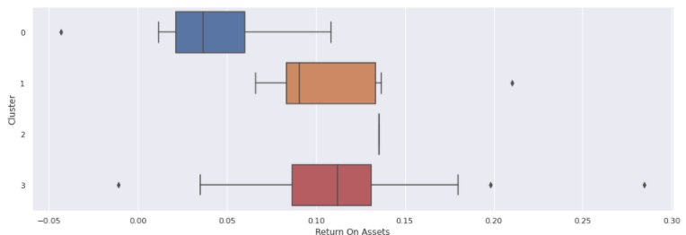
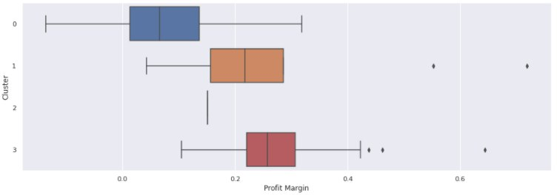
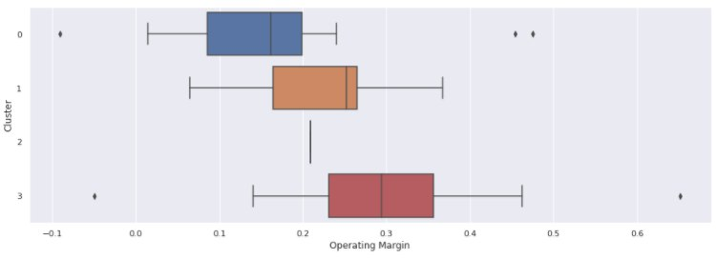
Profitability
Notes:
Lastly, the most paramount to our data visualisation would be the boxplots which provides a depiction of cluster data through their quartiles.
All other things being equal, a company with a higher ROE, ROA, Operating Margin and Profit Margin is preferred.
The boxplots show that cluster 3 does better in ROA, Operating Margin and Profit Margin
Moreover, the boxplot shows an outlier of cluster 2 that has exceptionally high ROE. We generally would weigh ROE higher than Operating Margin because ROE shows how well a company uses investment funds from shareholders to generate earnings so it is important to investors that a company has good ROE.
In our interest of finding profitable companies, we shall therefore include cluster 2 and 3 in our final analysis.

Slide 20
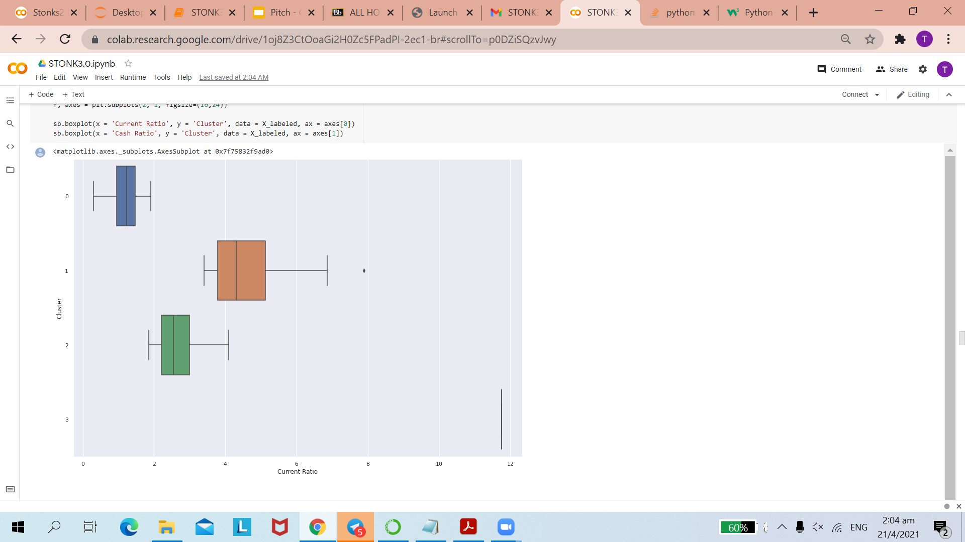
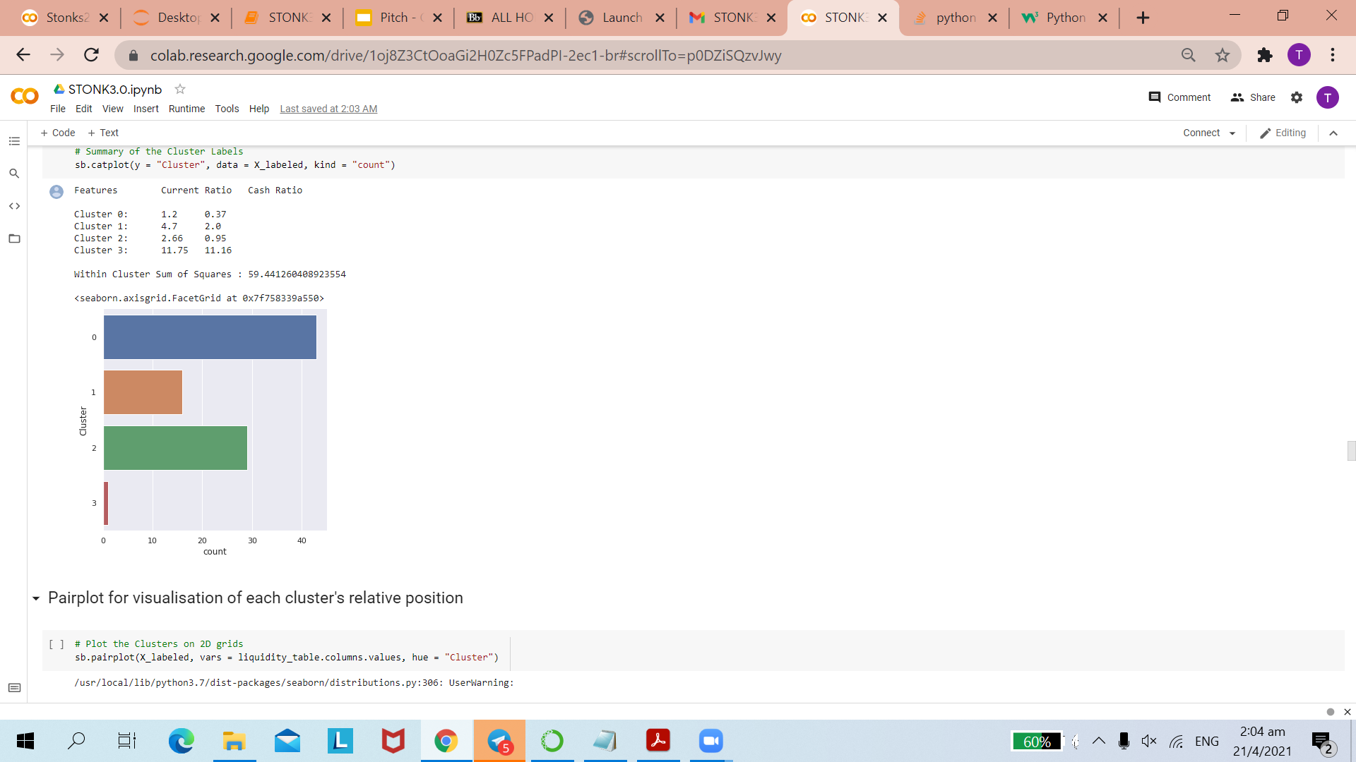
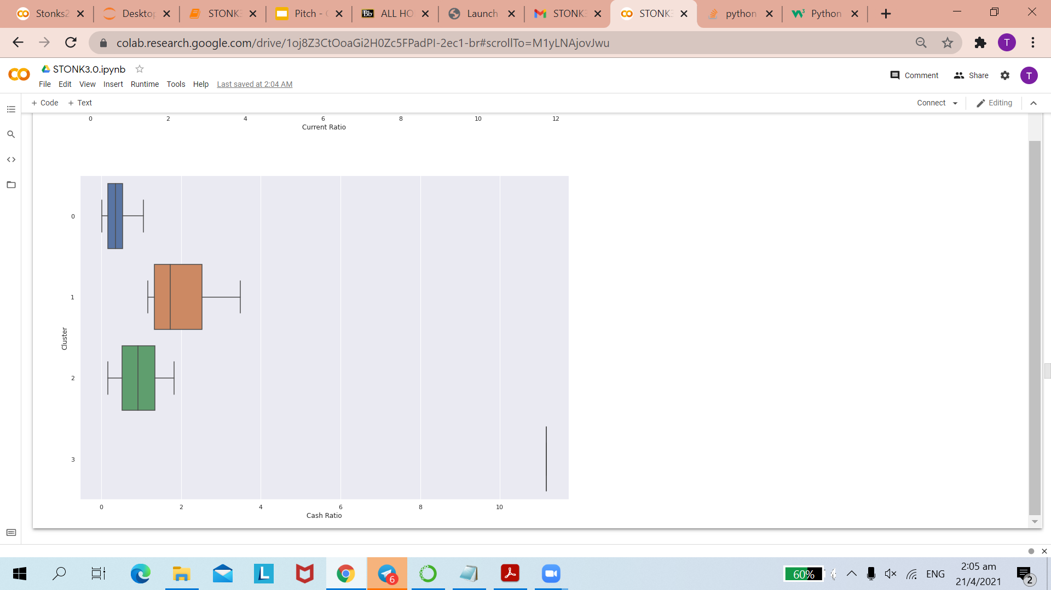
Liquidity
Notes:
Moving on to the other three ratios, a company with a higher Current Ratio and Cash Ratio is preferred.
Analysing the boxplots, we chose cluster 1 which performed better in both aspects as well as the outlier, cluster 3 that did exceptionally well in both aspects.

Slide 21
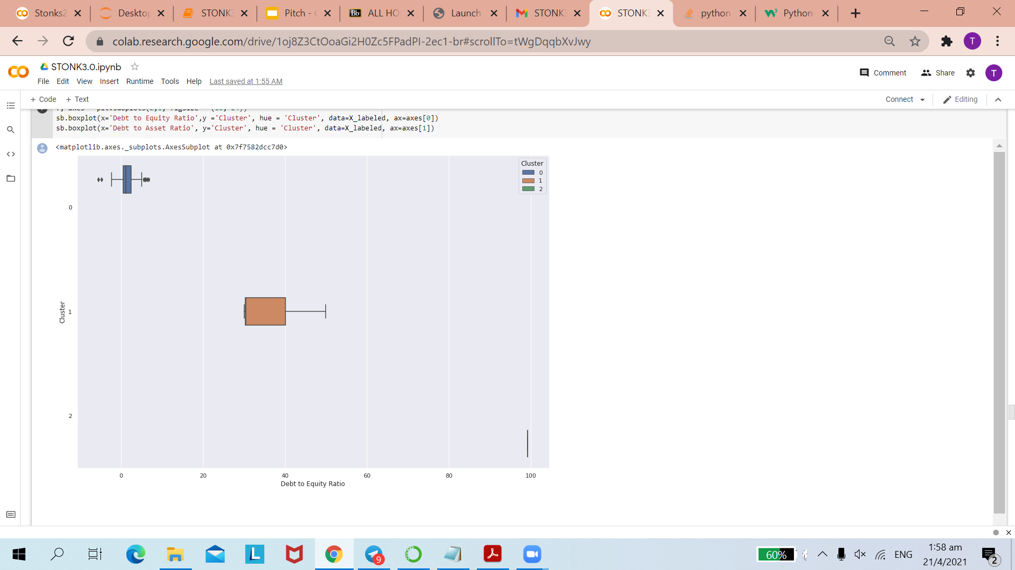
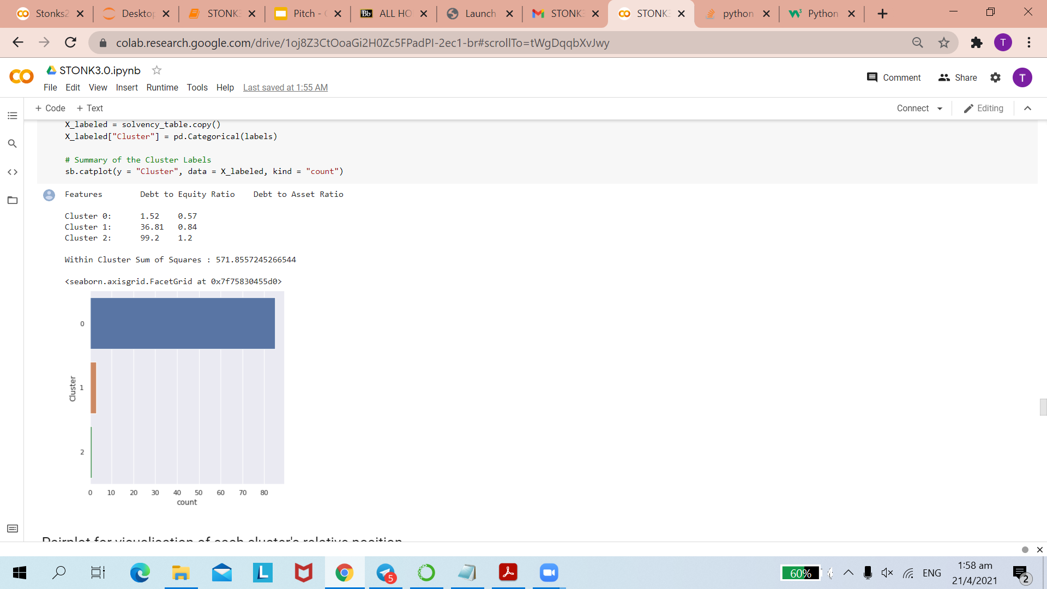
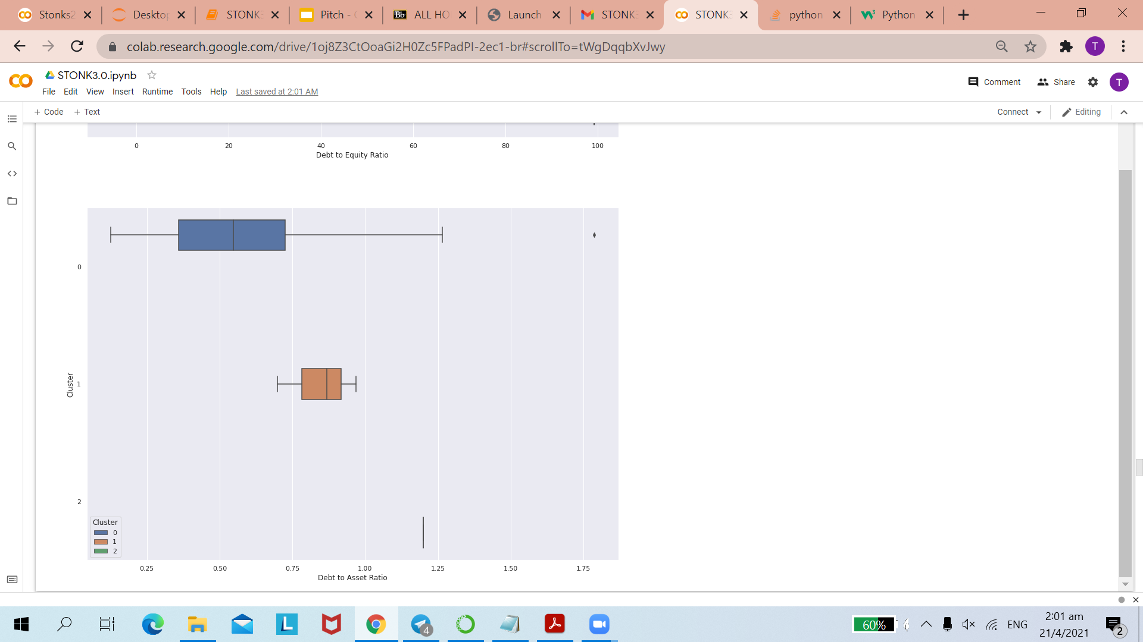
Solvency
Notes:
When looking at solvency, a company with a lower Debt-To-Equity Ratio and a lower Debt-To-Asset Ratio is preferred.
From the above boxplots, we can clearly observe that cluster 0 does better in both aspects. Hence, we will include it in our Final Analysis.

Slide 22
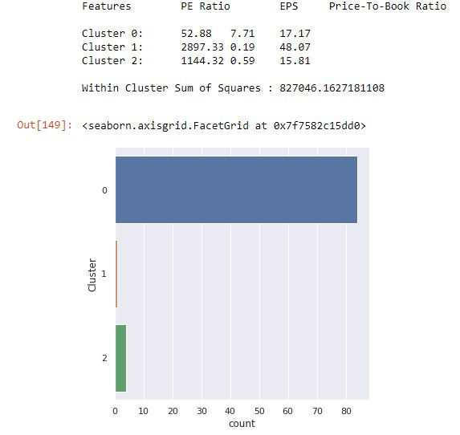
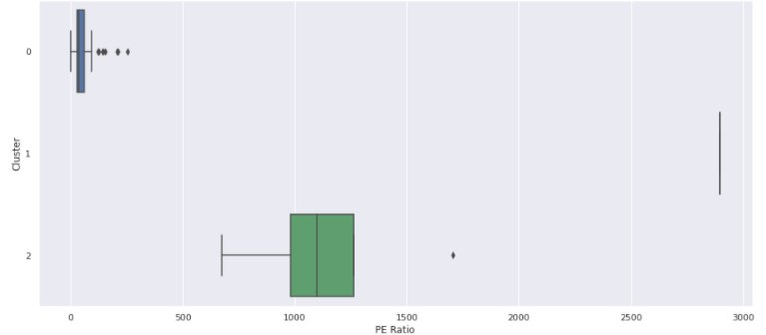
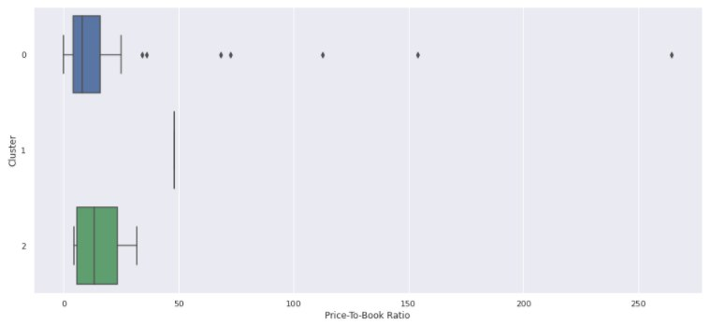
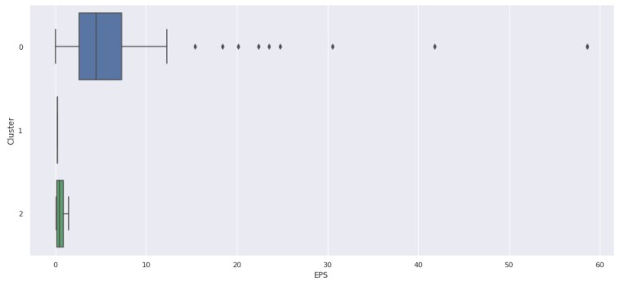
Market Prospects
Notes:
When comparing market prospects of a company, a low PE Ratio, high EPS and high Price-To-Book Ratio, is preferred.
Here we can observe that cluster 0 exhibits lower PE Ratio and higher EPS but lower Price-To-Book Ratio.
In our interest of finding the companies with the best market prospects, we have decided to choose cluster 0 as its shows more favourable results in 2 of the financial ratios as compared to just 1 other.

Slide 23
Evaluating Clusters
Notes:
Lastly, our evaluation considers the frequency of appearance of each company in the clusters and ranks them accordingly. Following which, we will have a clear visualisation of the top companies that does well in each metric.

Slide 24
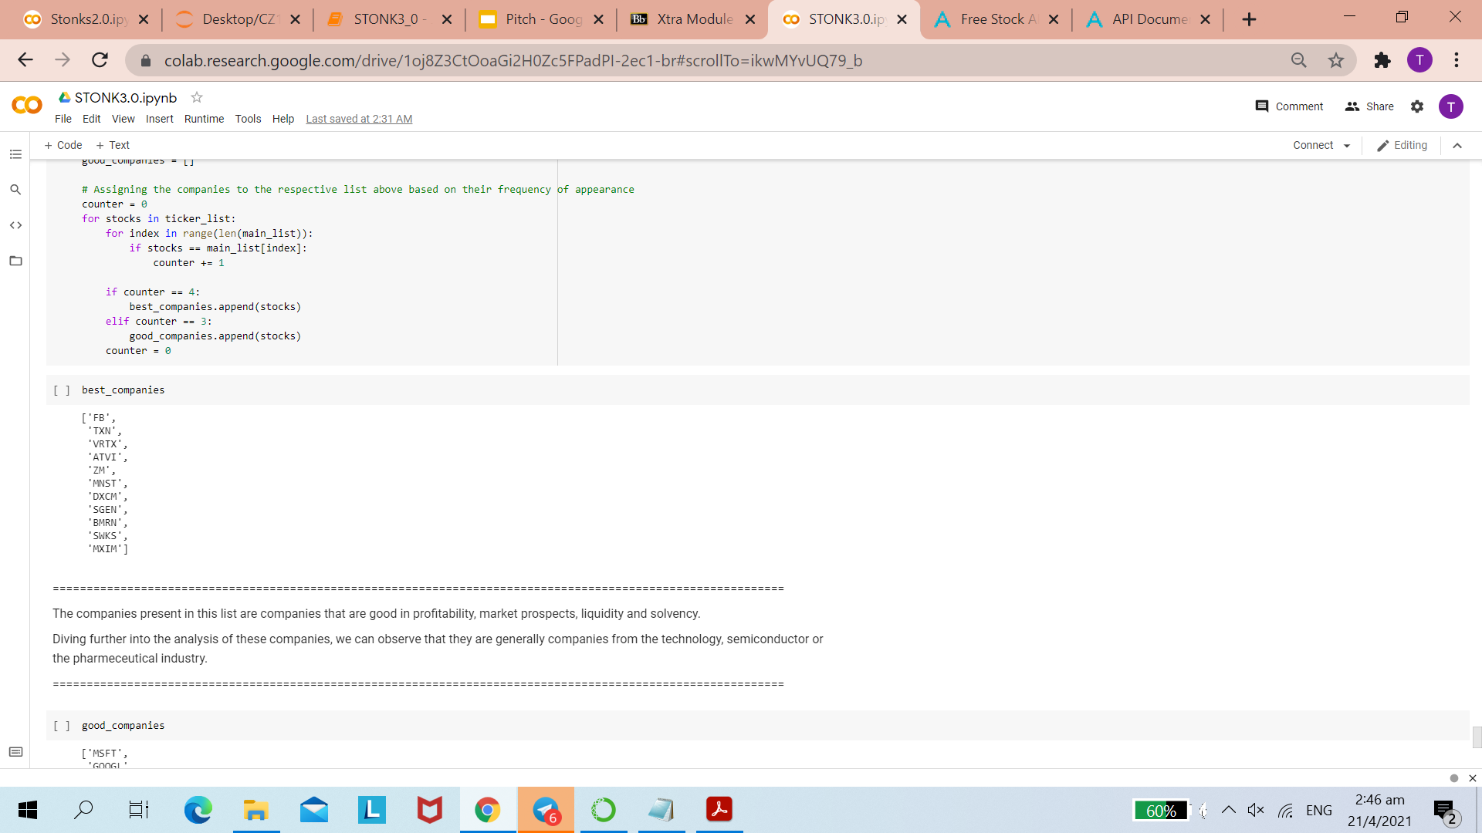
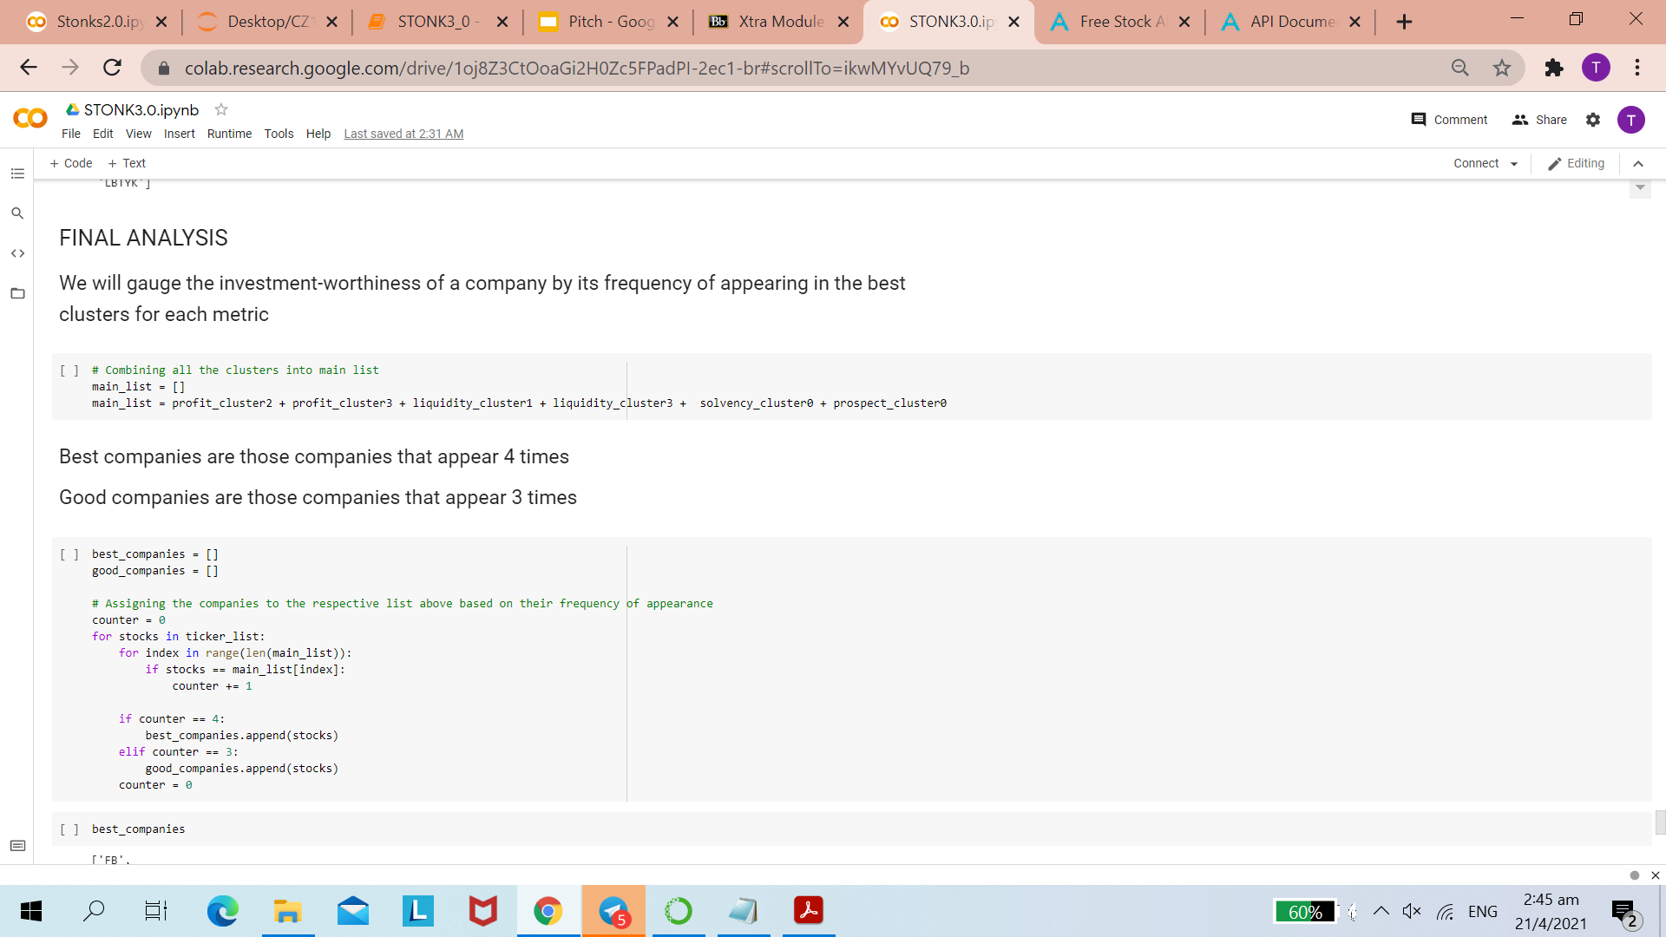
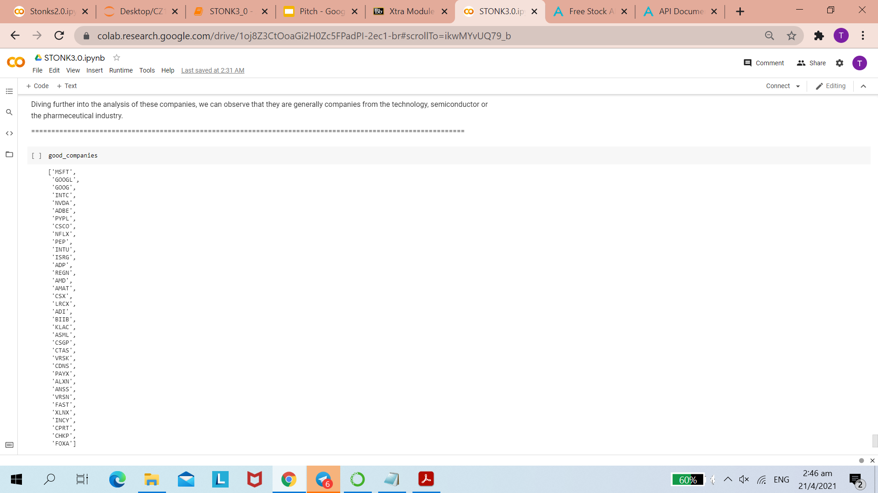
Final Analysis
Notes:
We will first extract the top performing clusters in each category and join them into a list. Our code will then run a count on how many times a companies’ name is repeated. We consider the best companies as those that appear in the list a total of four times. Companies that appear in 3 of the 4 clusters will be identified as good companies. For our category of best companies, we have these 11 companies that we would strongly encourage investors to look into as it emulates the quintessential characteristics of an investment worthy company.

Slide 25











Our Top Performers
Notes:
The companies present in this list are companies that are good in profitability, market prospects, liquidity and solvency.
Diving further into the analysis of these companies, we can observe that they are generally companies from the technology, semiconductor or the pharmeceutical industry.
Linking back to our problem statement, we have developed an algorithm to identify out of a given set of companies, the most investment-worthy of them. This is done through a cluster-based approach using 4 key financial metrics. This gives us and investors, a more informed decision backed by data analysis, thereby strengthening and diversifying our portfolio to maximise gains and capitalise on this well-rounded strategy created.

Slide 26
References
https://www.alphavantage.co/documentation/
https://www.investopedia.com/articles/stocks/06/ratios.asp
https://www.businesstoday.in/moneytoday/investment/key-financial-ratios-analyze-company-stock-investment/story/209789.html
https://www.investopedia.com/financial-edge/0910/6-basic-financial-ratios-and-what-they-tell-you.aspx
https://www.thebalance.com/financial-ratio-guide-357501
https://www.analyticsvidhya.com/blog/2019/08/comprehensive-guide-k-means-clustering/
https://towardsdatascience.com/machine-learning-for-stock-clustering-using-k-means-algorithm-126bc1ace4e1
https://towardsdatascience.com/clustering-analysis-on-stock-selection-2c2fd079b295
CZ1107 LAMS Xtra Module : Data-Driven Identification
https://lams.ntu.edu.sg/lams/tool/lanb11/learning/learner.do?toolSessionID=700605
Notes:
Here are our references. Our team has contributed evenly throughout the entire project from the problem formulation stage to programming the algorithm, to creating the final product that is this video. We hope you enjoyed. Thank you!

